Slide 1
IMDB MOVIES
Data Analysis
Prepared by:
Winnie Njoroge

Slide 2

Research Question
Analyse the IMDB dataset to advise Microsoft’s new studio on the best types of films to create.

Slide 3
Understanding the Context
Microsoft sees all the big companies creating original video content and they want to get in on the fun. They have decided to create a new movie studio, but they don’t know anything about creating movies. You are charged with exploring what types of films are currently doing the best at the box office. You must then translate those findings into actionable insights that the head of Microsoft's new movie studio can use to help decide what type of films to create.

Slide 4
Experimental Design
1. Defining the Question
2. Data Preparation
* Reading the Data
* Checking the Data
3. Data Cleaning
4. Feature Engineering
5. Performing EDA
* Univariate Analysis
* Bivariate and Multivariate Analysis
6. Summary and Conclusion
7. Data Relevance

Slide 5
Analysis
A Detailed analysis can be found on the following github repository hosting the data as well as Google Colab notebook: https://github.com/NjorogeWinnie/IMDB-Movie-Data-Analysis

Slide 6
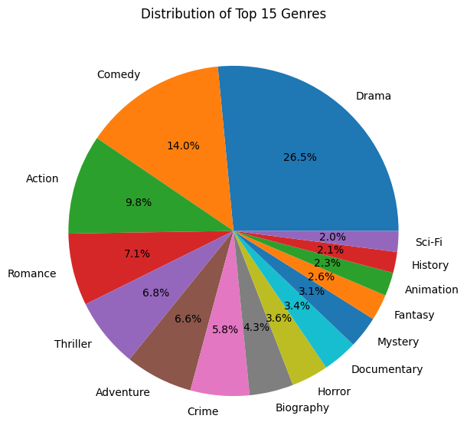
Distribution of Top 15 Genres
Based on this pie chart, we can see that drama, comedy and action are the most prevalent genres in this dataset. However, to make these findings actionable for Microsoft, we'd need to investigate if the prevalence of a genre correlates with its success. To do this we performed bivariate and multivariate analysis to draw meaningful conclusions.

Slide 7
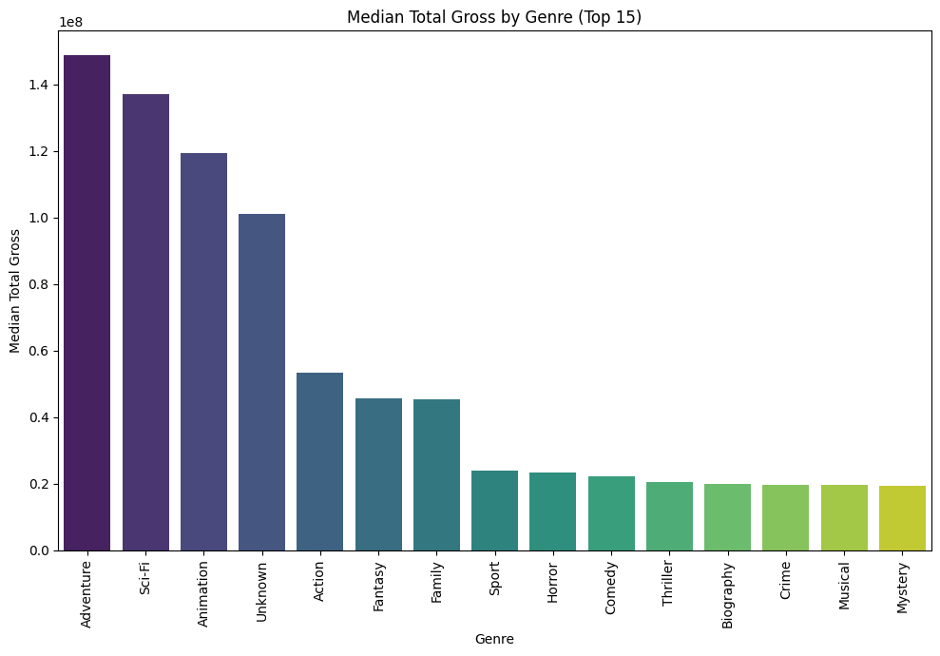
Genre vs. Gross Revenue
The bar graph clearly shows which genres have the highest median total gross. The genres with the tallest bars are, on average,, the most financially successful in this dataset. Based on the plot generated, Adventure, Sci-Fi, and Animation appear to be among the genres with the highest median total gross. For Microsoft's new movie studio, this bar graph highlights genres that have a historical track record of generating high median total revenue. These could be good starting points for considering what types of films to produce.

Slide 8
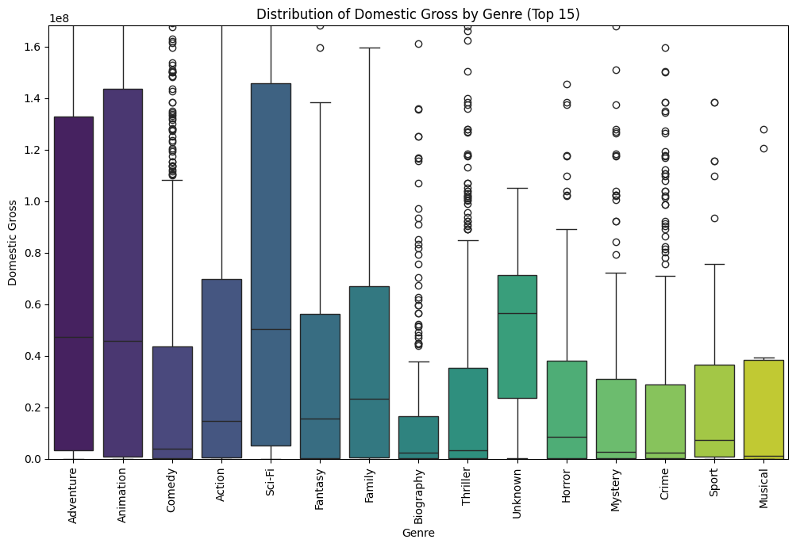
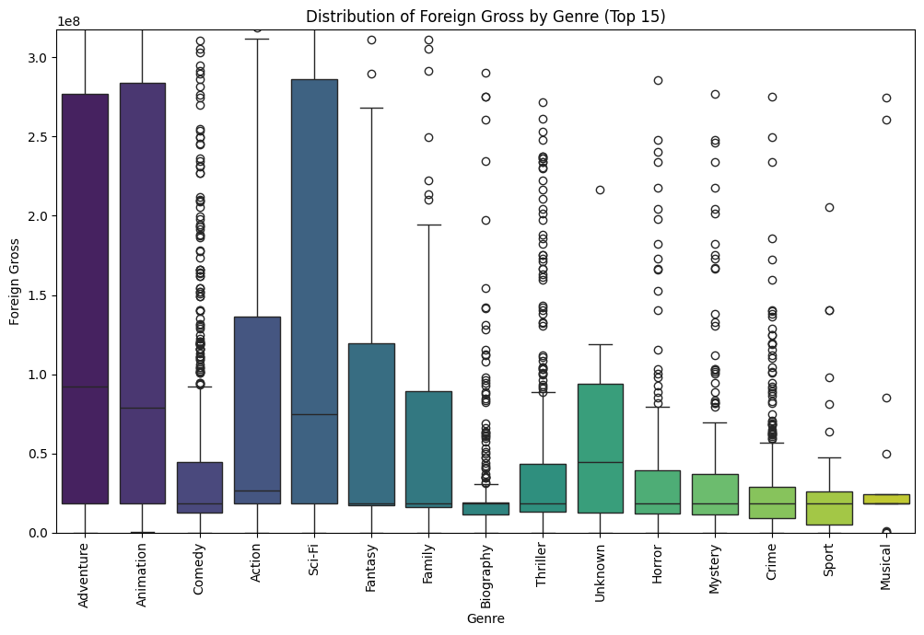
Genre vs. Gross Revenue
These box plots provide a more detailed view of the distribution of gross revenue within each of the top 15 genres, going beyond just the median. Some genres are more consistent earners (small boxes, few dots far away). Genres with many outliers at the high end indicate that while the median movie might not be the highest-grossing, the genre has the potential for producing extremely high-earning films. This is particularly relevant for a new studio aiming for box office success.
For Microsoft, these box plots provide crucial context to the median values from the bar graph. They help differentiate between genres that are consistently solid performers (higher median, lower variability) and genres that have a high potential for huge hits but also more risk (lower median, higher variability, more outliers).

Slide 9
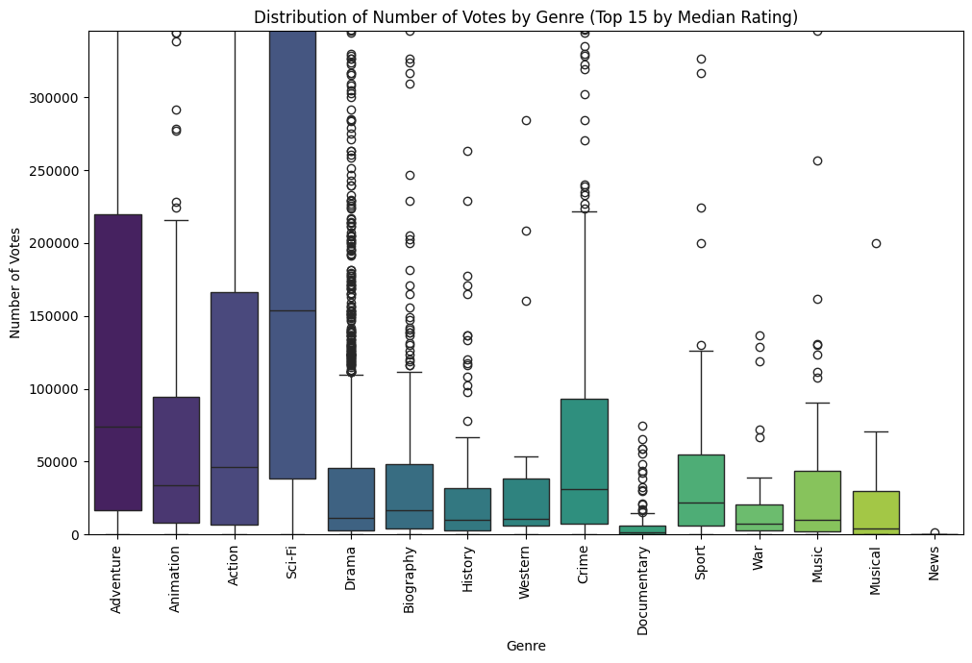
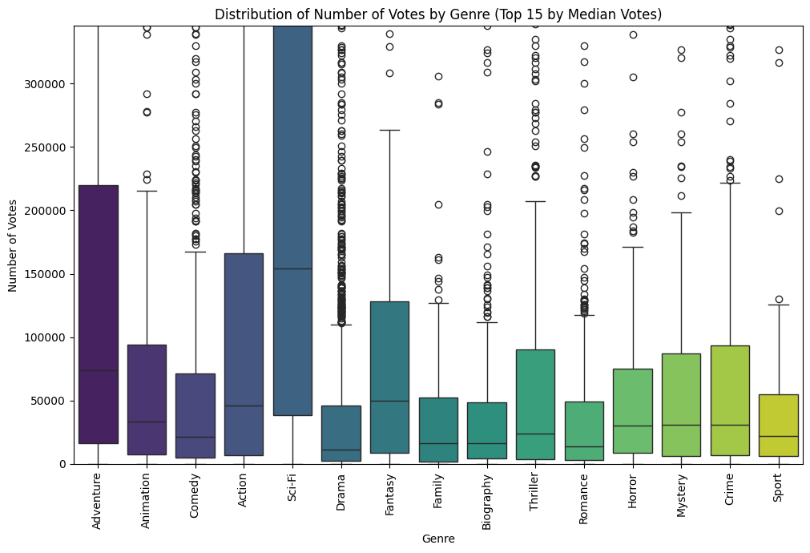
Genre vs. Ratings and Votes
Genres like Documentary, History, and Biography tend to have higher median average ratings. Genres like Sci-Fi, Adventure, and Action tend to have a higher median number of votes, suggesting they generate more audience engagement and potentially wider reach. Genres that are critically acclaimed (higher ratings) are not always the same genres that attract the most votes (popularity/engagement). For example, Documentaries might have high ratings but fewer votes compared to Action or Sci-Fi films.Understanding both ratings and votes is important. High ratings might indicate critical success or appeal to a niche audience, while high vote counts often correlate more strongly with broad popularity and, as we saw earlier with gross revenue.
Microsoft can use this information to consider whether they want to focus on genres that are critically safer bets (potentially lower risk in terms of reception) or genres that have the potential to be major hits with high audience engagement and vote counts, even if the average rating is lower or more variable.

Slide 10
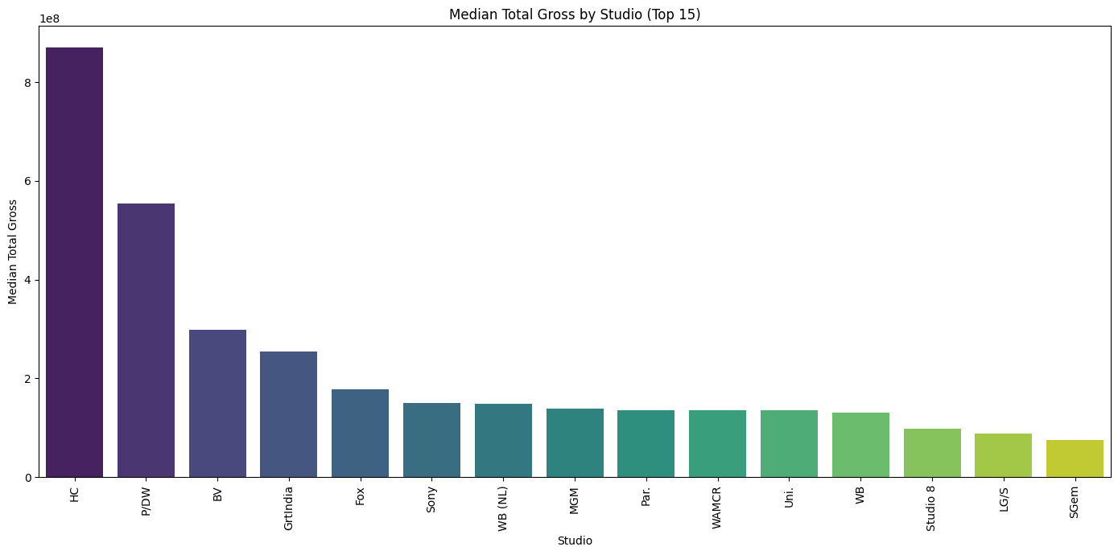
Studio vs. Gross Revenue
The bar plot clearly highlights the studios with the highest median total gross revenue. These are the studios whose typical movies tend to earn the most globally. Based on the output, studios like HC, P/DW, and BV appear to have the highest median total gross.

Slide 11
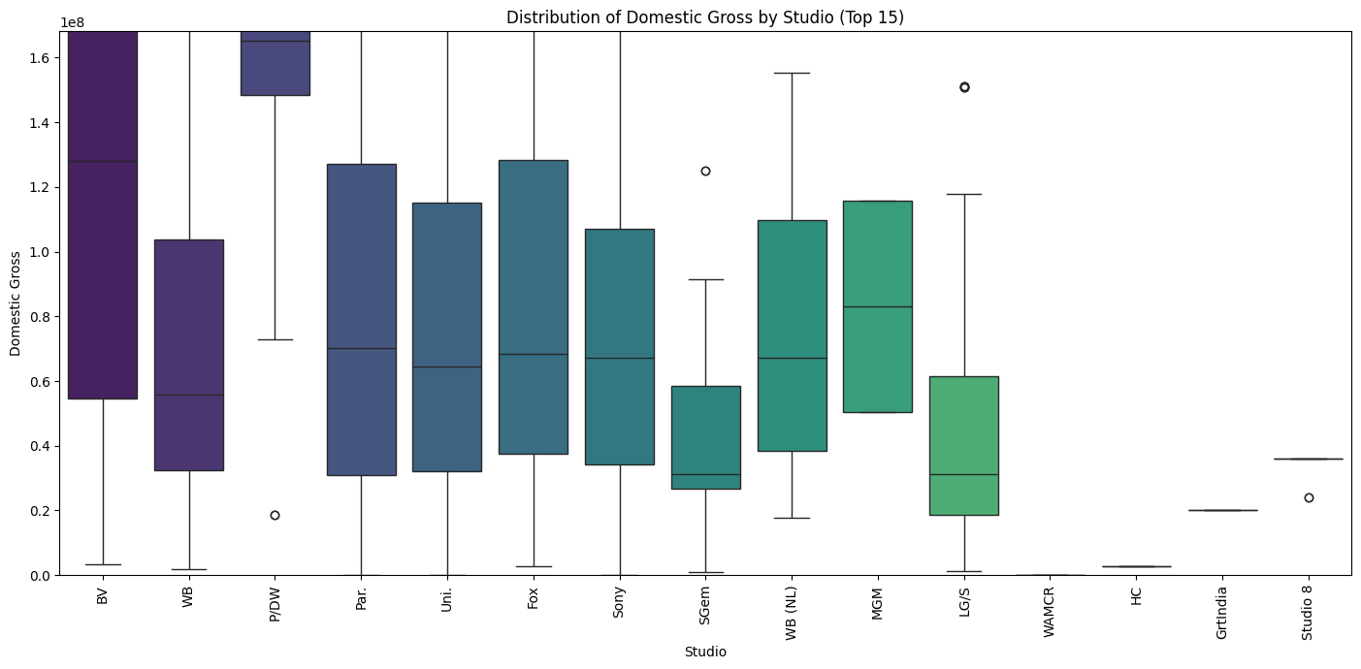
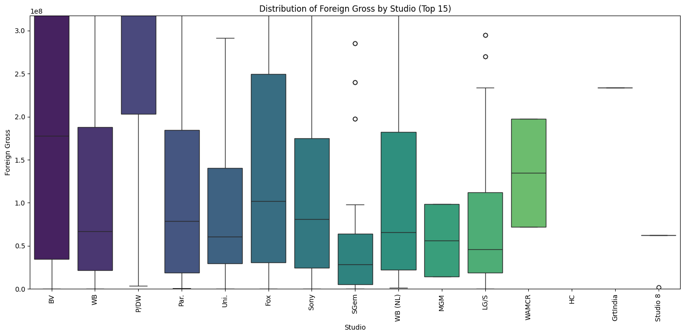
Studio vs. Gross Revenue
The box plots for domestic and foreign gross by studio reveal the variability in performance within each studio. Some studios have tight boxes, suggesting consistent performance across their films.
Other studios have wider boxes and many outliers, indicating that while their median gross might be lower, they have a higher potential for producing massive blockbusters.This provides insights into the competitive landscape which helps Microsoft understand which existing studios are most financially successful based on median gross., the typical range and variability of earnings for movies produced by these top studios, whether certain studios excel in domestic or foreign markets, or in producing consistent earners versus high-risk/high-reward blockbusters.
This information can inform Microsoft's strategy regarding potential partnerships, talent acquisition, or the types of films they might aim to produce based on the performance patterns of established studios.

Slide 12
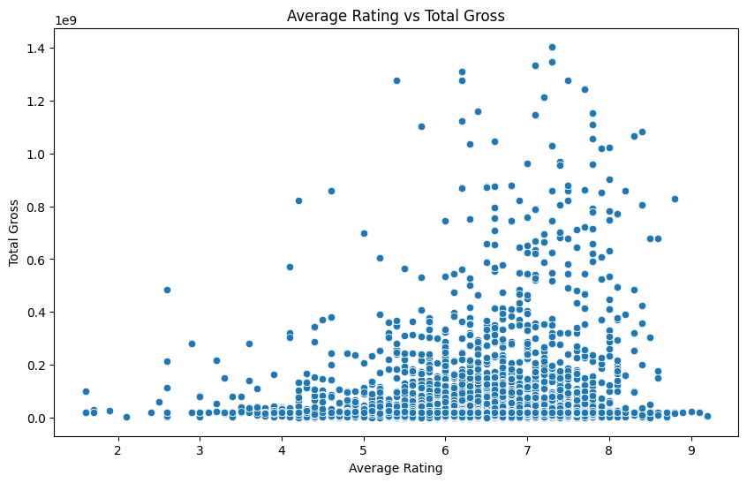
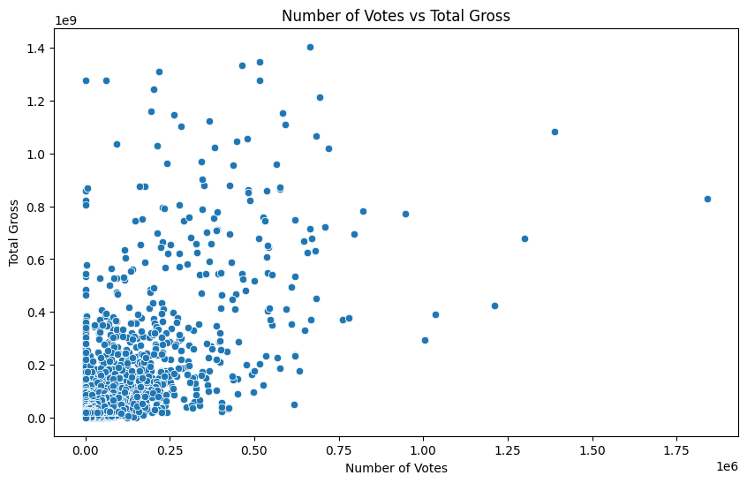
Relationship between Ratings/Votes and Gross Revenue
The scatter plot of averagerating vs total_gross generally shows a weak positive trend. While there are some high-grossing movies with high ratings, there are also many high-grossing movies with average or even below-average ratings. Similarly, there are movies with high ratings that did not achieve very high total gross. A high average rating does not guarantee high box office success, and many successful movies are not necessarily the most critically acclaimed.
The scatter plot of numvotes vs total_gross shows a clearer positive trend than the rating vs. gross plot. As the number of votes increases, the total gross tends to increase. This suggests that movies that generate more audience engagement (indicated by a higher number of votes) are more likely to achieve higher box office revenues. There are also some outliers with very high total gross that also have a large number of votes.

Slide 13
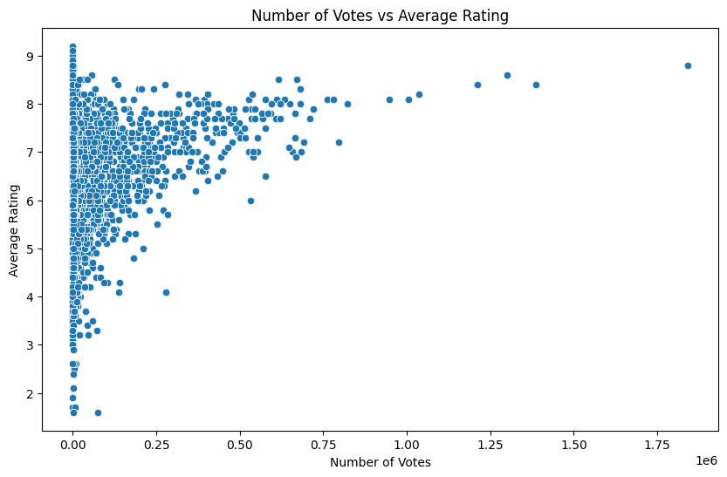
Relationship between Ratings/Votes and Gross Revenue
The scatter plot of numvotes vs averagerating shows a moderate positive trend. Movies with more votes tend to have slightly higher average ratings, although there is still a significant spread in ratings, even for movies with many votes. This indicates that while popular movies might be rated slightly higher on average, high popularity doesn't guarantee a perfect rating, and movies with fewer votes can still have very high or very low ratings.
Overall Insights for Microsoft:
Audience Engagement Matters for Revenue: The number of votes appears to be a better indicator of potential total gross than the average rating. This suggests that focusing on making movies that resonate with a large audience and generate significant buzz (leading to more votes) might be a more reliable strategy for financial success than solely aiming for critical acclaim.
Ratings and Revenue are Not Strongly Coupled: High ratings are desirable but are not a strong predictor of high box office revenue on their own.
Popularity and Ratings are Moderately Related: Movies that are popular (high votes) tend to have slightly higher ratings, but it's not a strict rule.
These findings emphasize the importance of audience reach and engagement (reflected in vote counts) as a driver of box office revenue, more so than just the average rating.

Slide 14
Conclusion
Based on the data and our analysis, here are the main takeaways:
Genre Performance: Genres like Adventure, Sci-Fi, and Animation tend to have the highest median total gross revenue, indicating a strong potential for financial success. While Drama, Comedy, and Action are the most prevalent genres in the dataset, their median gross revenues are lower than the top-performing genres. The box plots reveal significant variability in gross within many genres, with some genres (like Adventure and Sci-Fi) showing a high potential for blockbuster hits (outliers).
Studio Performance: The analysis of studio performance shows that some studios consistently achieve higher median gross revenues than others. Understanding the strategies and focus of these top-performing studios could be valuable.
Audience Engagement (Votes) is a Strong Indicator of Gross Revenue: The number of votes a movie receives has a moderate positive correlation with its gross revenue. This suggests that movies that generate more public interest and discussion tend to perform better financially. Average Rating has a Weaker Correlation with Gross Revenue: While there's a slight positive relationship, a high average rating alone does not guarantee high box office success. Critically acclaimed films are not always the highest-grossing, and many successful films have average ratings.
Runtime and Release Year: Within the timeframe of this dataset (2010-2018), runtime and the specific year of release do not appear to be strong predictors of a movie's financial success or reception.

Slide 15
Recommendations
Recommendations for Microsoft's New Movie Studio:
Focus on High-Median Gross Genres with Blockbuster Potential: Consider prioritizing genres like Adventure, Sci-Fi, and Animation, which show high median total gross and a tendency to produce blockbuster hits. While these might be competitive spaces, the data suggests they offer strong financial upside.
Prioritize Audience Engagement: Given the stronger correlation between the number of votes and gross revenue compared to average rating, focus on developing films that are likely to resonate with a broad audience and generate buzz and popularity.
Learn from Top Studios: Analyze the types of films, genres, and scales of production of consistently high-performing studios in the top tiers. This could provide insights into successful strategies and market positioning.
Ratings are Important, but Not the Sole Determinant of Financial Success: While aiming for quality and positive reviews is valuable for reputation and potentially attracting some audience segments, do not solely rely on achieving high critical ratings as a guarantee of box office success.

